Slide 1
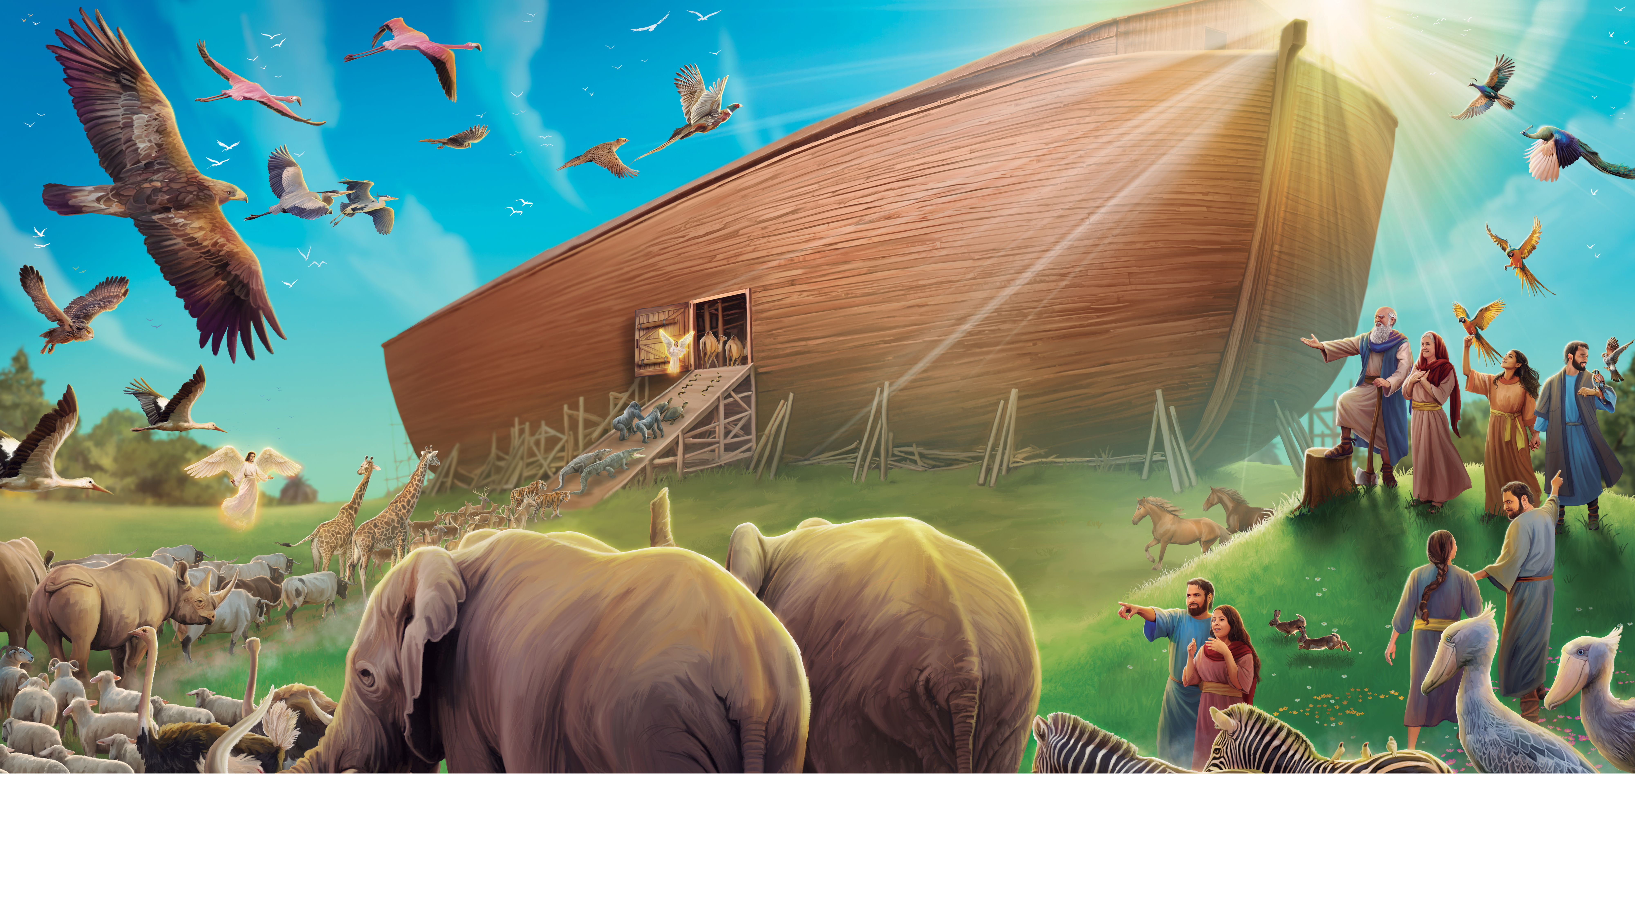
Welcome to Sabbath School

Slide 2
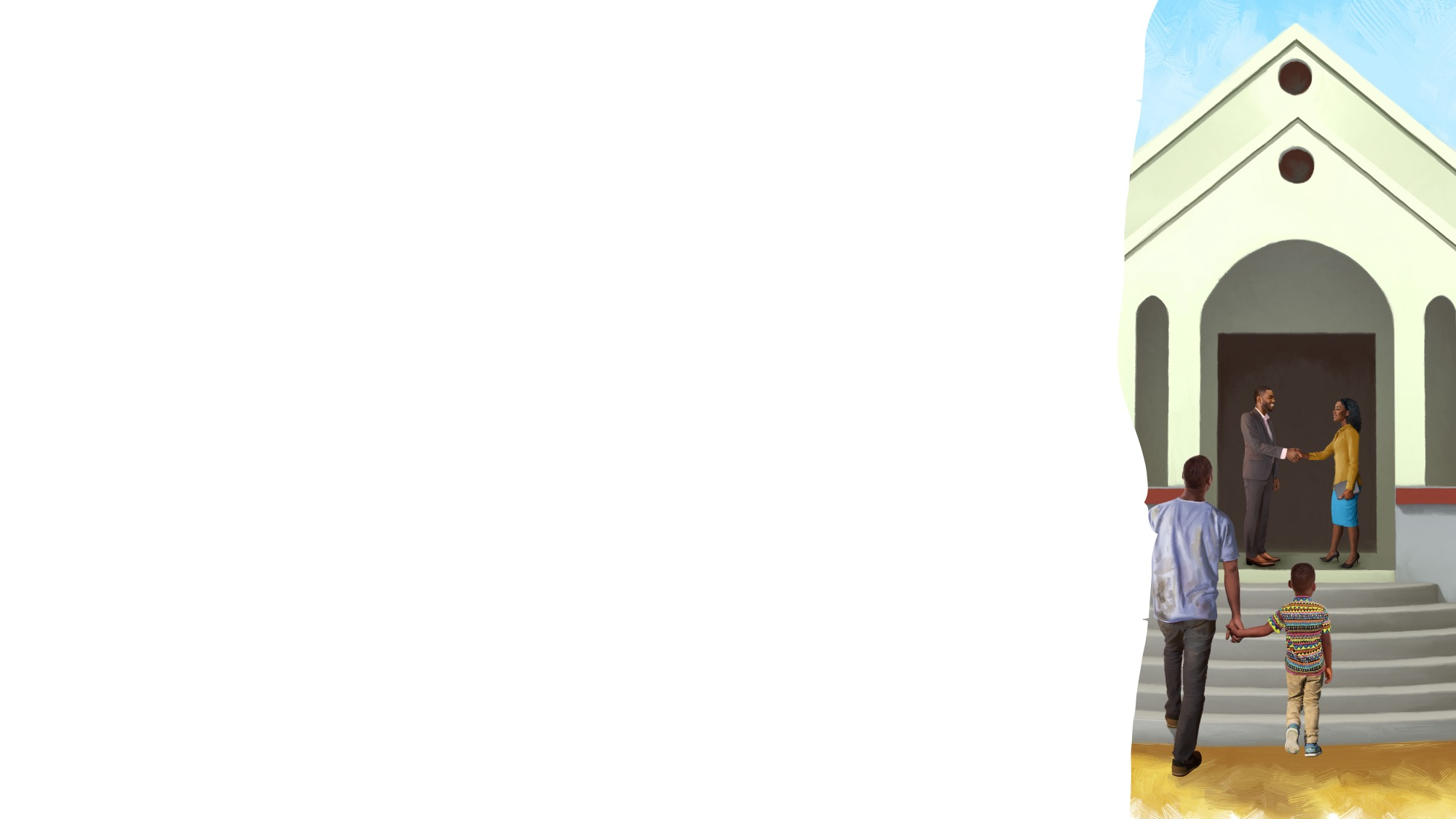
EARLY ARRIVALS

Slide 3

Pack it Up
EARLY ARRIVALS
Pack it up and pick it up and put it away.
Now it’s time to listen,
To sing and pray.
It’s so good to be here
And to see you again.
Come, sit down,
Let’s talk about our special Friend.
Come, sit down,
Let’s talk about our special Friend.
“Pack It Up” by Coralie Fraser. Arrangement Copyright © 2025 General Conference Corporation® of Seventh-day Adventists.

Slide 4
Welcome to Sabbath School

Slide 5
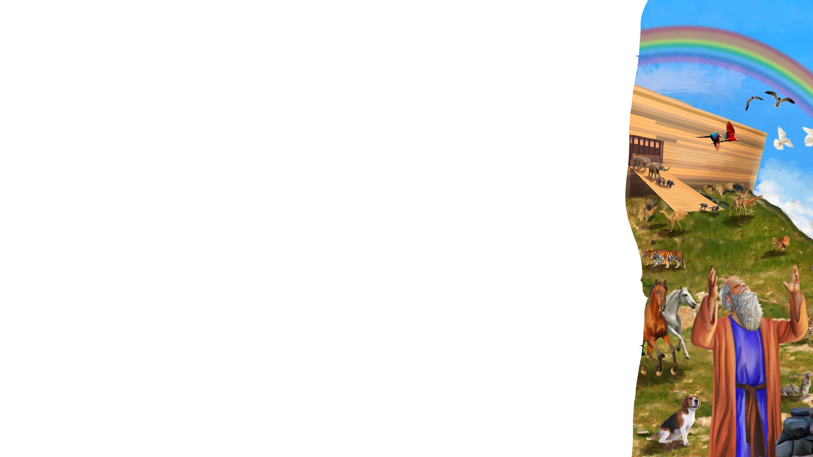
Good Morning Jesus
WELCOME AND SONGS
One, two, three,
Lift up your voice and sing.
Four, five, six,
Let’s say, “Good morning, Jesus.”
Seven, eight, nine,
It’s Sabbath School time.
One, two, three, four, five, six, seven, Eight, nine, ten, let’s sing it again.
(Repeat above)
(Actions or props)
“Good Morning Jesus” by Rosie Smith. Copyright © 2024 General Conference Corporation® of Seventh-day Adventists.

Slide 6
God’s Big Family
WELCOME AND SONGS
We are all a part
Of God’s big family.
With Jesus in our hearts,
We are brothers and sisters.
God’s big family
Is all around the world.
God’s big family
Is all around the world.
(Repeat above)
“God’s Big Family” by Rosie Smith. Copyright © 2025 General Conference Corporation® of Seventh-day Adventists.

Slide 7
God Is Our Loving Father
WELCOME AND SONGS
God is our loving Father.
He wants to bless us with good things.
God is our loving Father.
I want to choose to obey Him.
I can trust God’s promises;
What God has said, He will do.
I can trust God’s promises,
For God’s word is always true.
(Continued on next slide.)

Slide 8
God Is Our Loving Father
WELCOME AND SONGS
God is our loving Father.
He wants to bless us with good things.
God is our loving Father.
I want to choose to obey Him.
I can trust God’s promises;
What God has said, He will do.
I can trust God’s promises,
For God’s word is always true.
(Continued on next slide.)

Slide 9
God Is Our Loving Father
WELCOME AND SONGS
God is our loving Father.
He wants to bless us with good things.
God is our loving Father.
I want to choose to obey Him.
“God Is Our Loving Father” by Rosie Smith. Copyright © 2025 General Conference Corporation® of Seventh-day Adventists.

Slide 10
Happy Birthday
WELCOME AND SONGS
Happy birthday, happy birthday,
Happy birthday to you.
Jesus loves you dear ___________.
Happy birthday to you.
(Repeat above)
“Happy Birthday” by Janet Sage, copyright © 2001 North American Division Corporation of Seventh-day Adventists. From Little Voices Praise Him, #39. Used by permission.

Slide 11
Visitor Song
WELCOME AND SONGS
We have a new friend
With us today.
We have a new friend.
Let’s smile and wave.
We welcome you to Sabbath School.
We’re glad you came.
We welcome you,
And hope to see you again. (x2)
“Visitor Song” by Rosie Smith. Copyright © 2024 General Conference Corporation® of Seventh-day Adventists.

Slide 12
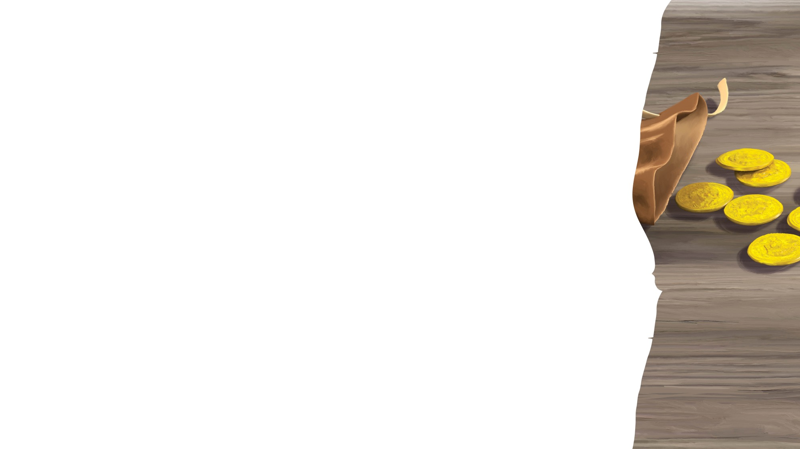
MISSION
FAST FACT
& OFFERING CHART

Slide 13
For Jesus
OFFERING
For Jesus, I want to bring
My money as an offering.
For Jesus, I want to bring
My money as an offering.
An offering to worship my King
To show I’m thankful for His blessings.
An offering to worship my King
To show I’m thankful for His blessings.
(Continued on next slide.)

Slide 14
For Jesus
OFFERING
For mission, I want to bring
My money as an offering.
For mission, I want to bring
My money as an offering.
An offering to worship my King
To show I’m thankful for His blessings.
An offering to worship my King
To show I’m thankful for His blessings. (X2)
“For Jesus” by Rosie Smith. Copyright © 2024 General Conference Corporation® of Seventh-day Adventists.

Slide 15
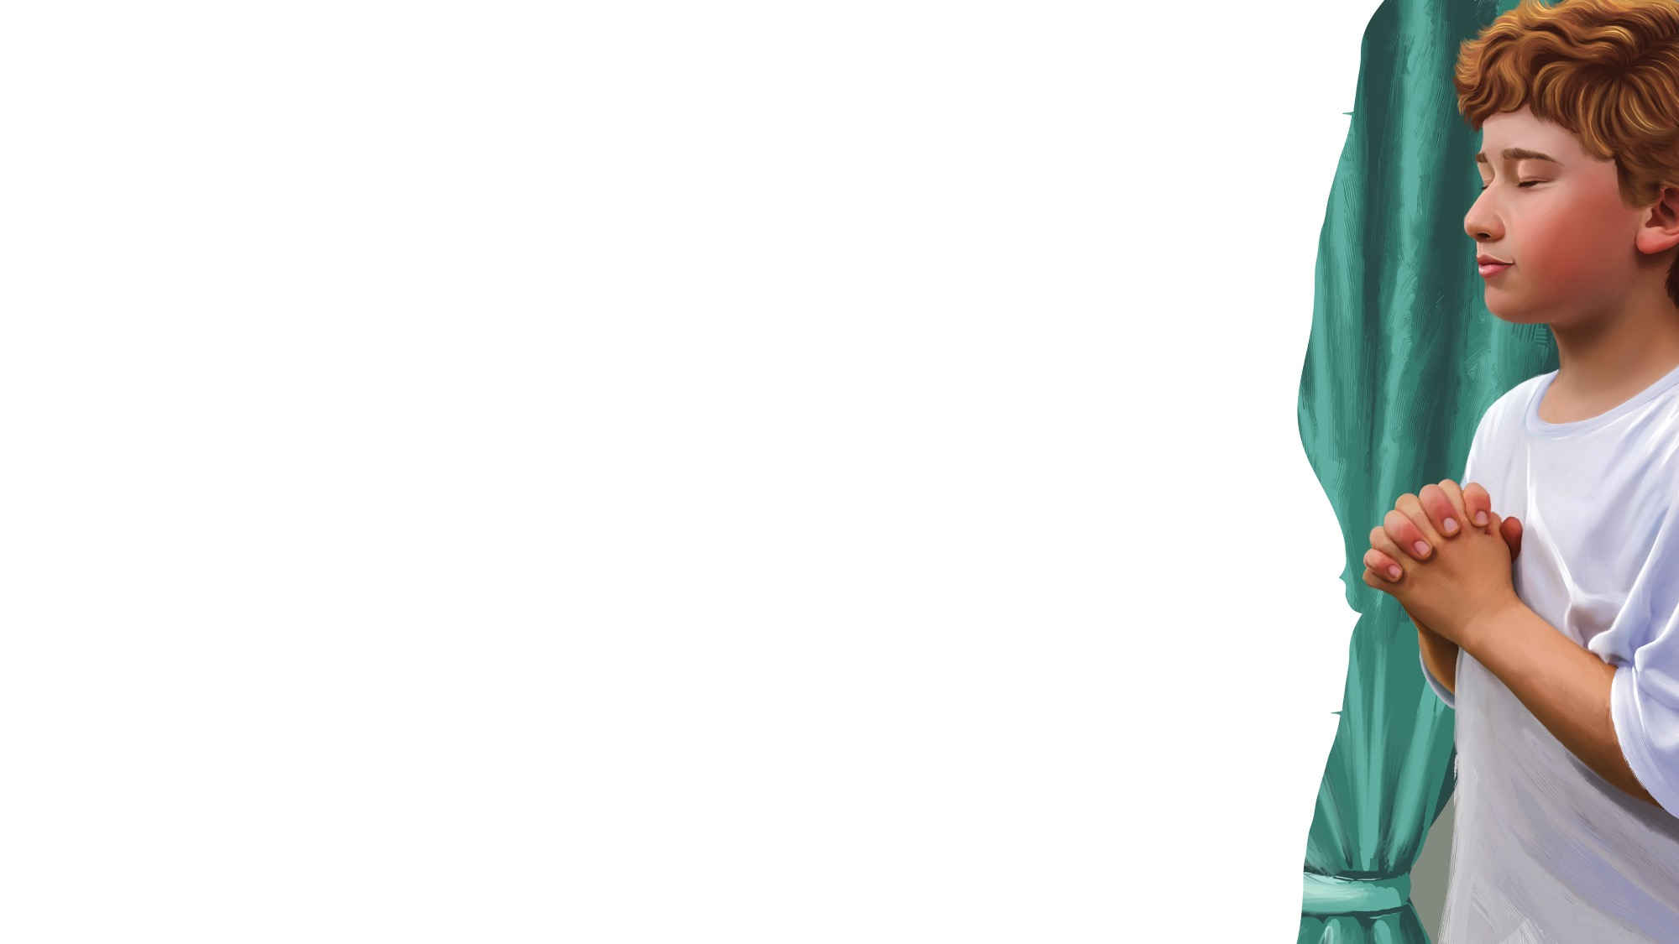
Let’s Pray
PRAYER TIME
Anytime, anywhere,
We can say a little prayer
To our Father in heaven,
Who hears us.
(Repeat above)
Let’s pray. (Fold your hands.)
Let’s pray. (Close your eyes.)
Let’s pray.
“Let’s Pray” by Rosie Smith. Copyright © 2024 General Conference Corporation® of Seventh-day Adventists.

Slide 16

GOD’S
WORD

Slide 17
GOD’S WORD
The Greatest Treasure
If I dug down deep in the dirt,
I would never find
A treasure as great as God’s Word, Full of wisdom and truth.
It’s better than diamonds,
It’s better than gold,
The greatest story ever told,
It’s the Bible.
Yes, it’s the Bible.
(Repeat above)
“The Greatest Treasure” by Rosie Smith. Copyright © 2024 General Conference Corporation® of Seventh-day Adventists.

Slide 18
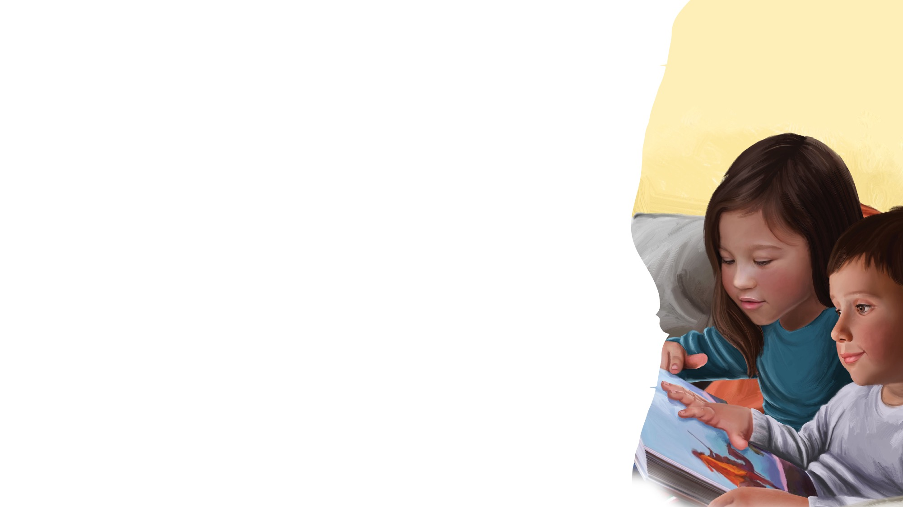
MEMORY VERSE
For the wages of sin
is death, but the gift of God is eternal life
in Christ Jesus our Lord.
Romans 6:23

Slide 19
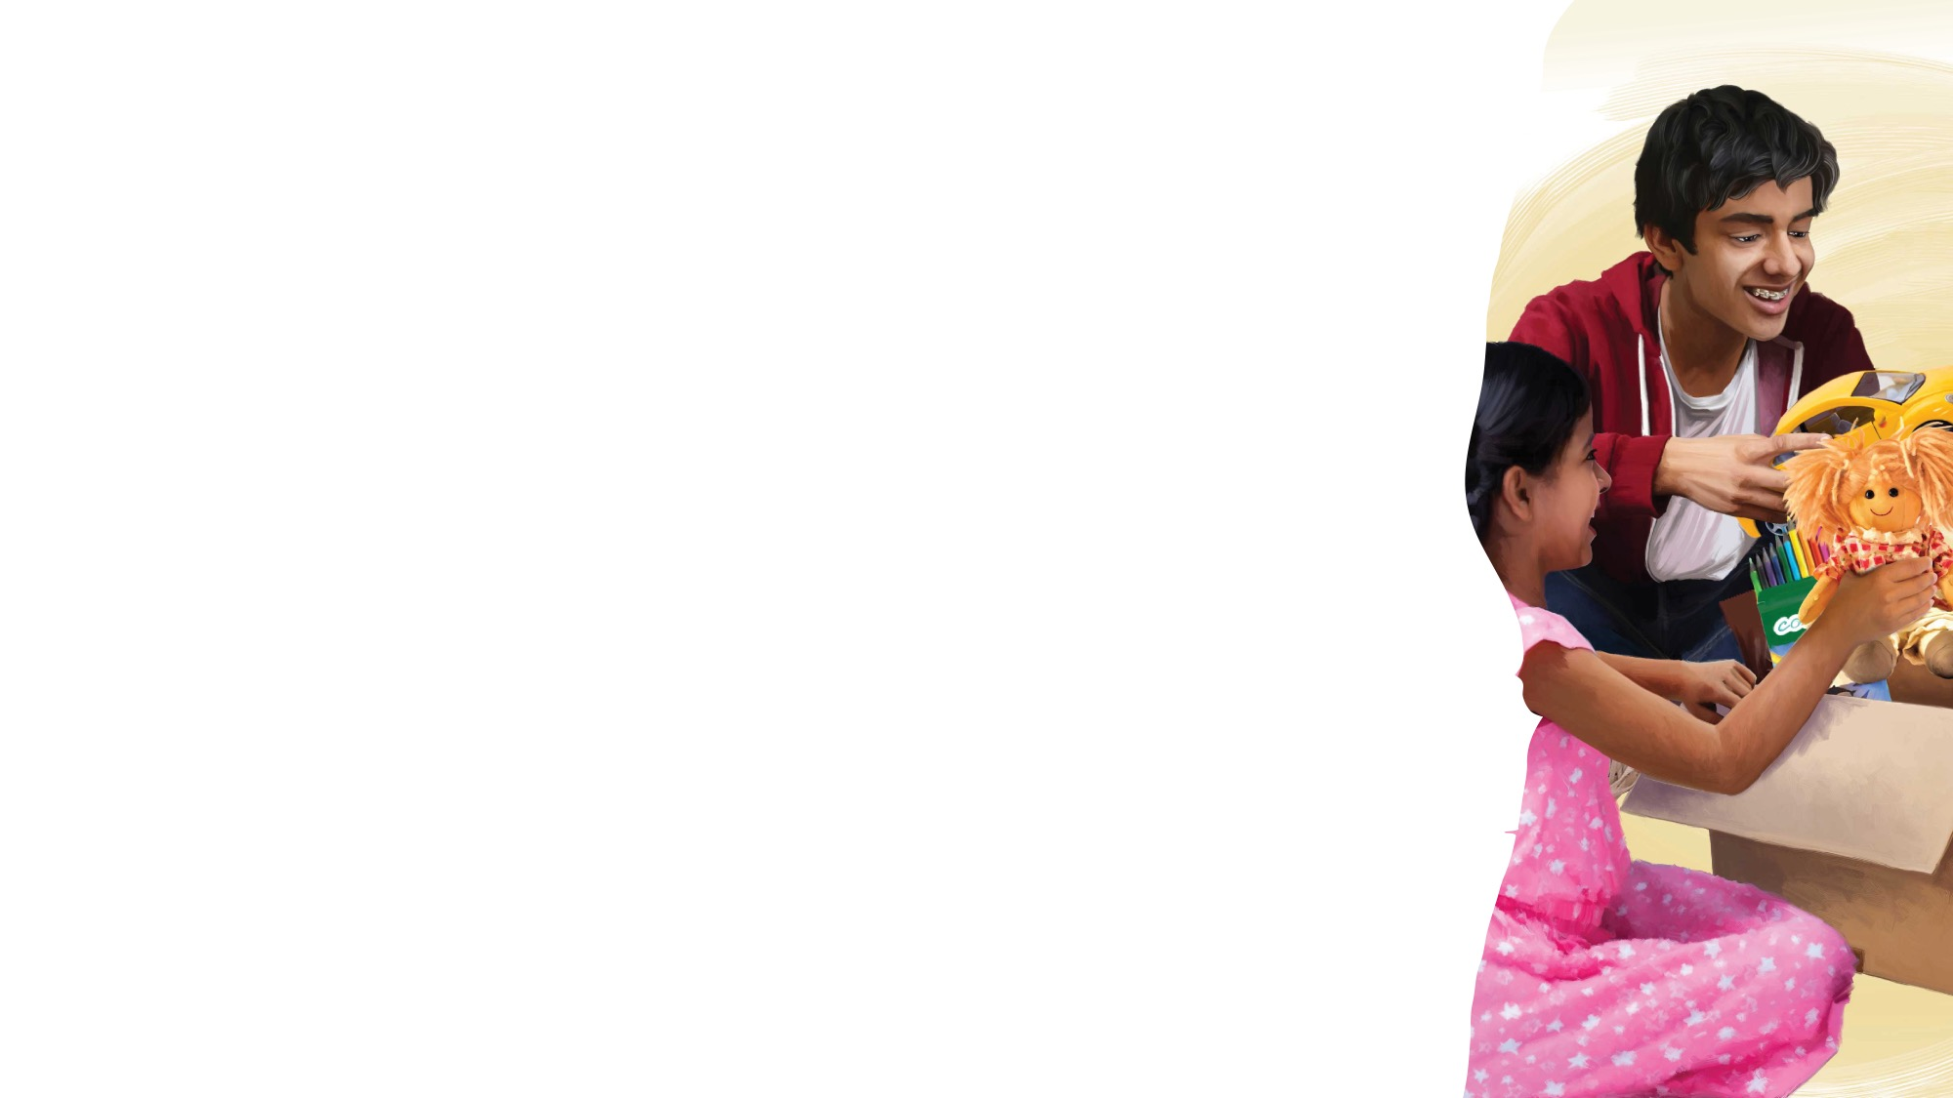
SECRET
SURPRISE
BOX

Slide 20
BIG IDEA
God is loving. He took my consequences.

Slide 21
TELL
THE
STORY

Slide 22


Slide 23
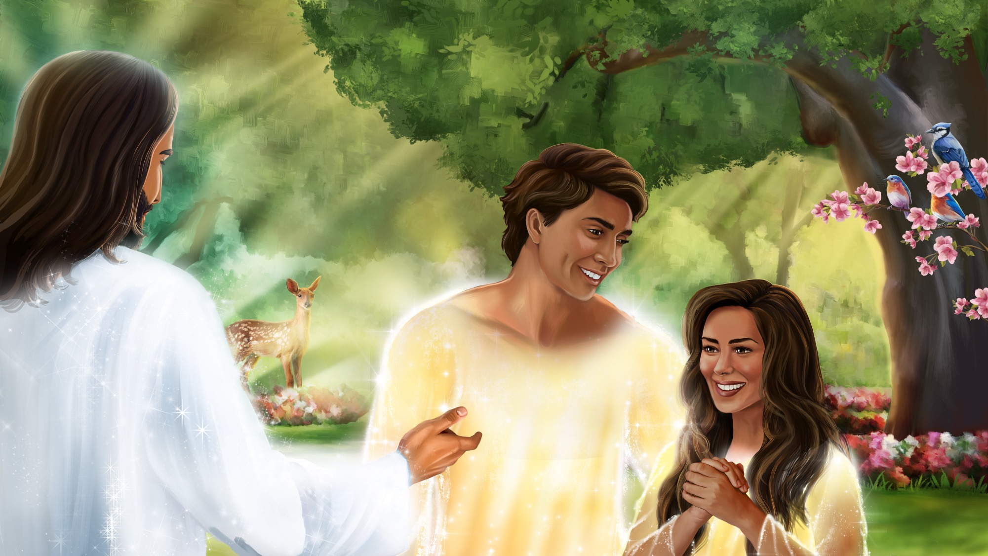

Slide 24
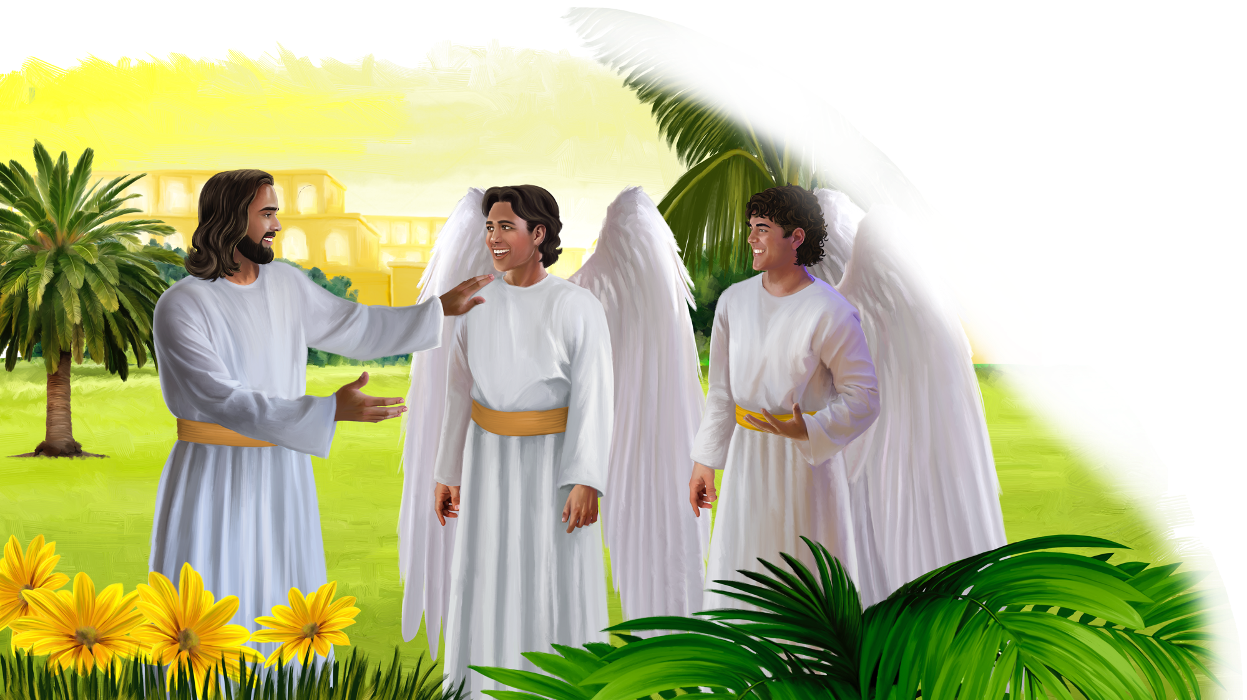

Slide 25


Slide 26
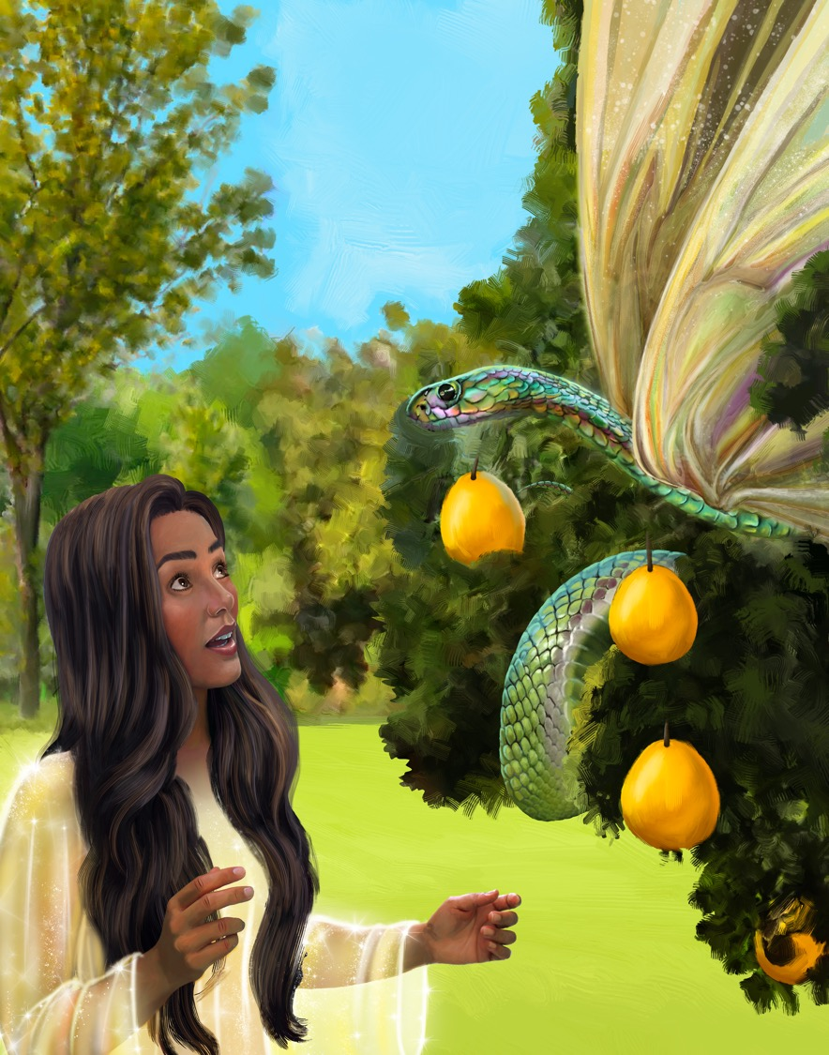

Slide 27
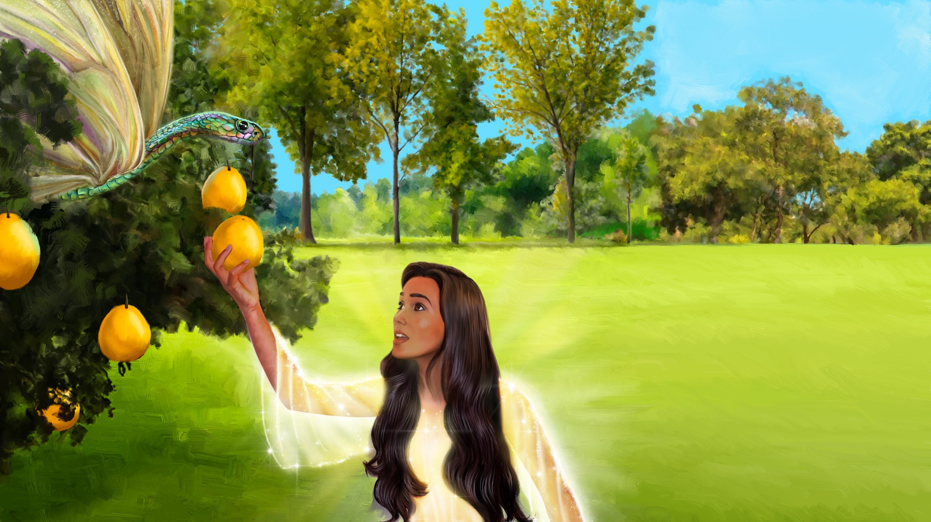

Slide 28
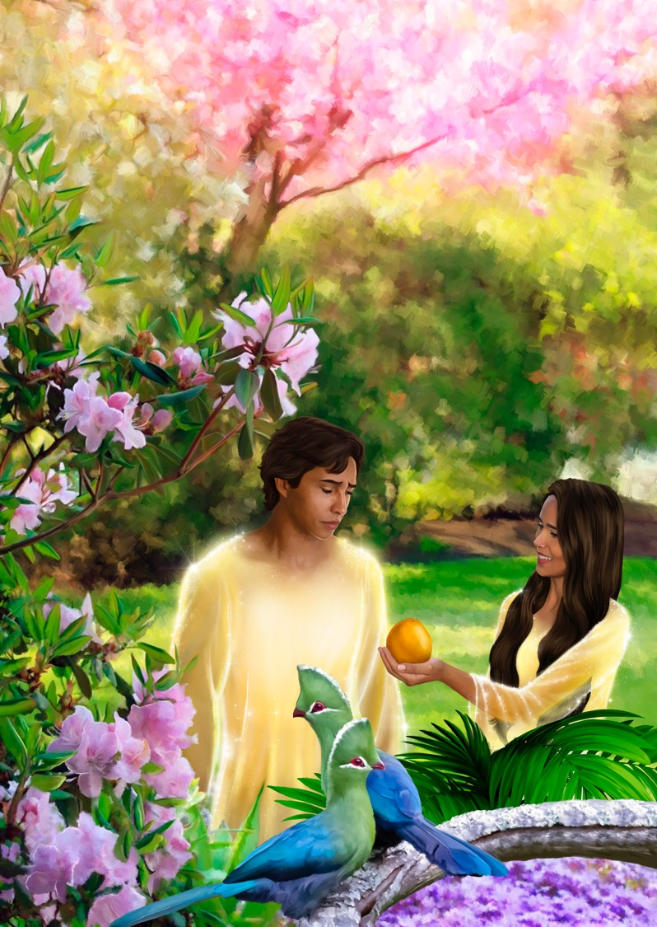

Slide 29


Slide 30


Slide 31
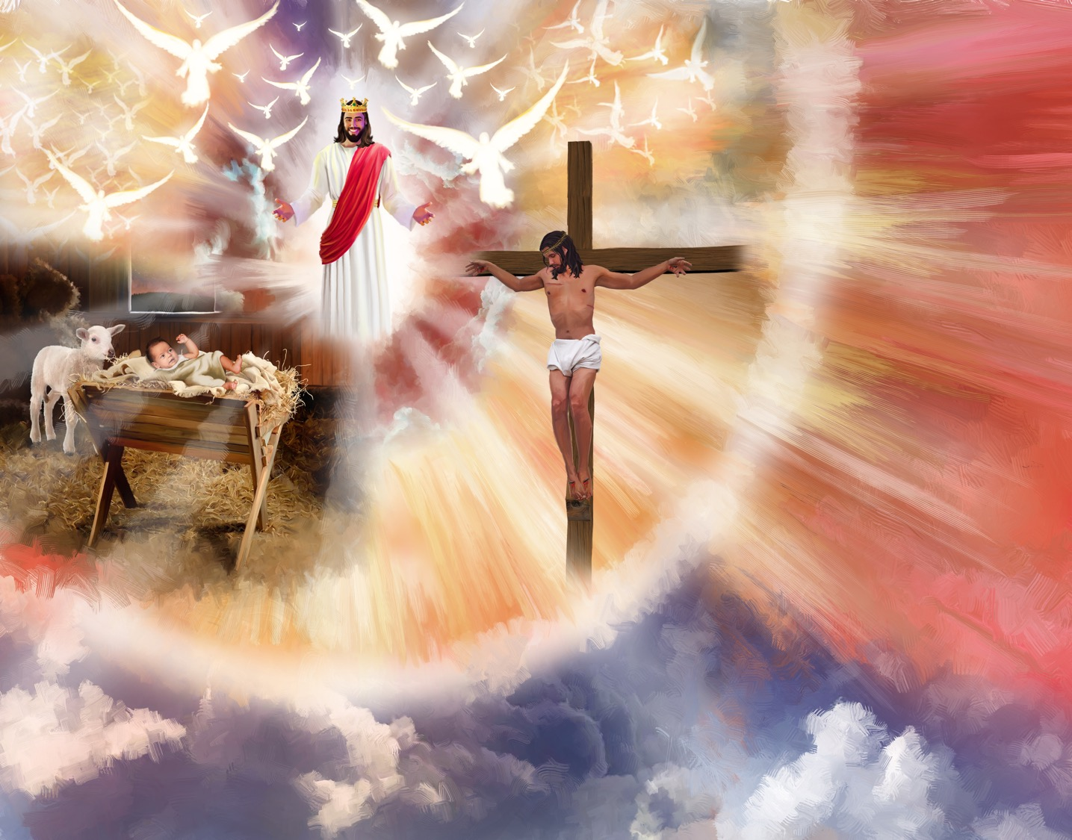

Slide 32
STORY
EXPLORER BOX

Slide 33
BIG IDEA
God is loving. He took my consequences.

Slide 34

NATURE & MISSION

Slide 35
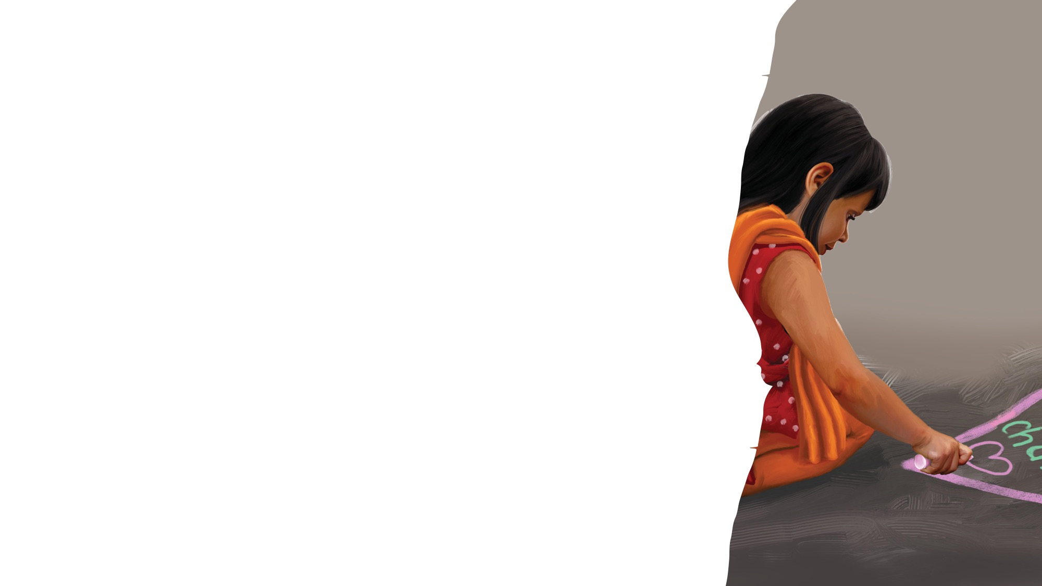
CRAFT
TIME

Slide 36
REVIEW

Slide 37
BIG IDEA
God is loving. He took my consequences.

Slide 38
MISSION CHALLENGE

Slide 39
Goodbye Song
CLOSING
Sabbath School has come to an end
(Clap, clap).
It’s time to say “Good-bye” to my friends (Clap, clap).
God bless you till we meet again.
God bless you.
(Repeat above)
“Goodbye Song” by Rosie Smith. Copyright © 2024 General Conference Corporation® of Seventh-day Adventists.

Slide 40
Prayer

